Slide 1
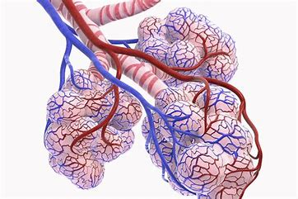
Gas exchange
AEHBY ATAR Human Biology

Slide 2
Review
What type of tissue is blood? Why? (what features does it have that give it this classification)
Why is the inside of the lungs moist?
Distinguish between active and passive transport across cell membranes.
Describe the sequence and structures involved in expiration (be sure to mention chest volume and air pressure).

Slide 3
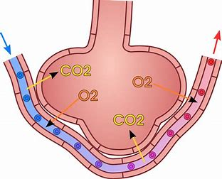
Learning Intentions
the efficient exchange of gases in the lungs is maintained by the actions of breathing, blood flow and the structure of the alveoli

Slide 4
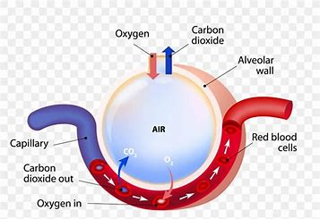
Success Criteria
Draw the microscopic structure of alveoli and their capillaries
Describe (name) the blood supplies involved in gas exchange in the lungs
Relate structure to function for gas exchange in the alveoli and capillaries
List and explain the three factors which assist alveolar gas exchange.

Slide 5
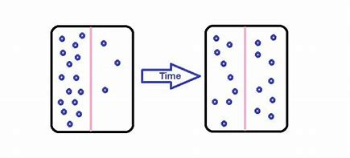
Gas exchange
Gases move passively by simple diffusion.

Slide 6
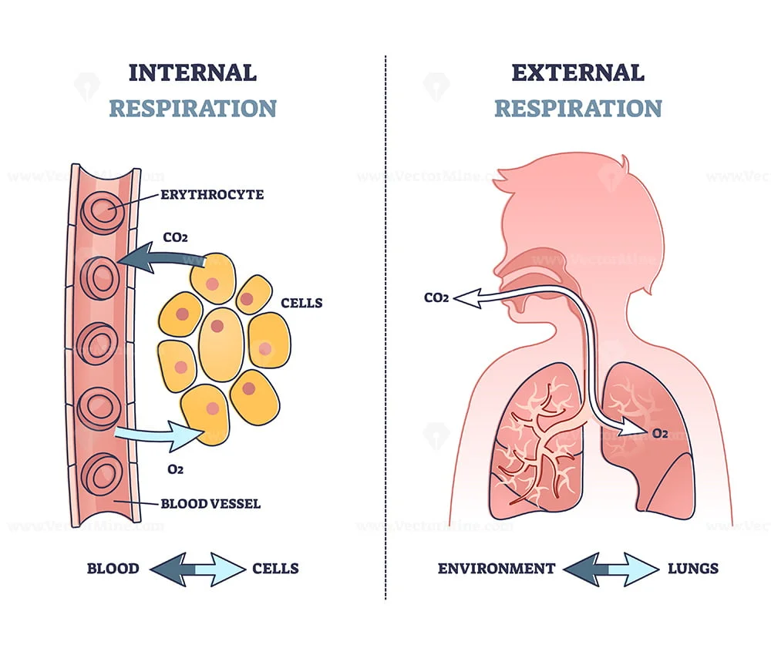
External respiration:
Bulk movement of air into and out of the lungs

Slide 7
Internal respiration:
Capillary gas exchange in body tissues.

Slide 8
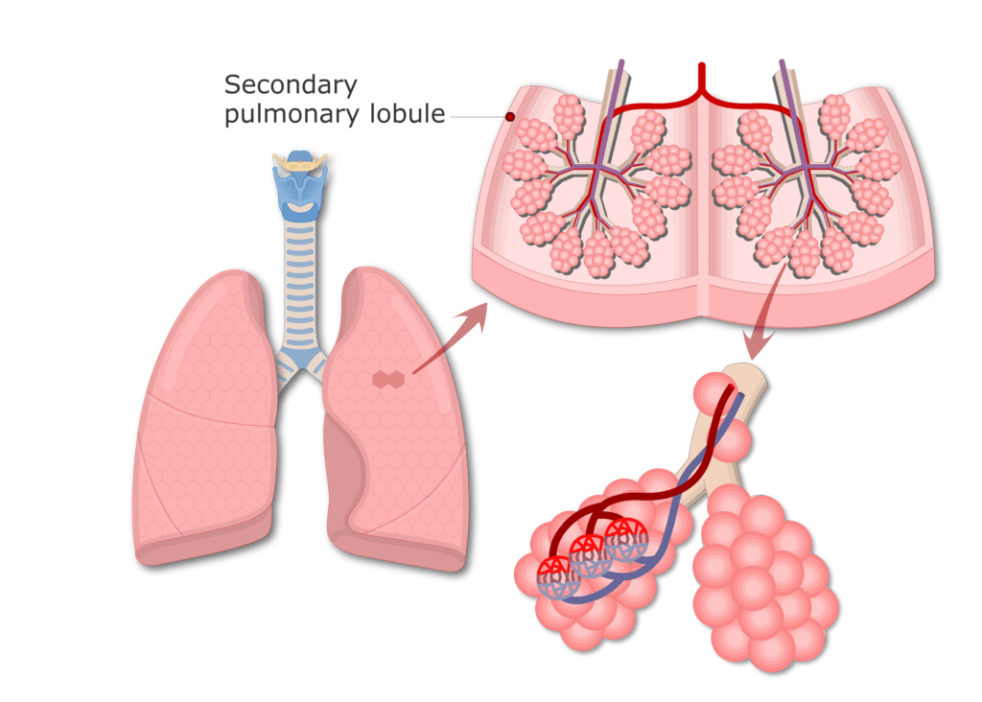
Alveolar gas exchange
Surface area:
Alveoli provide huge surface area for membrane exchange (50-80m²).

Slide 9
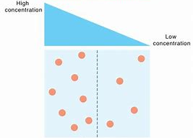
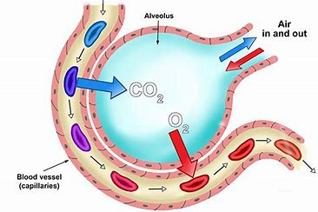
Alveolar gas exchange
2. Concentration gradient: Continuous flow of blood and replacement of air inside lungs maintains concentration gradient (high CO2 and low O2 inside capillaries compared to inside alveoli); moisture in alveoli allows gases to dissolve prior to diffusion.

Slide 10
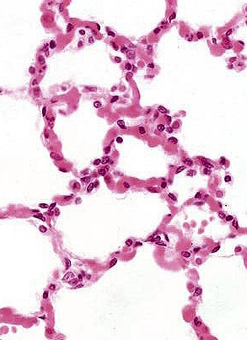
Alveolar gas exchange
3. Thin membranes:
Alveoli wall is very thin epithelium, only 1 cell thick, and capillaries similar so there is very little distance and few membranes for gases to diffuse through.

Slide 11
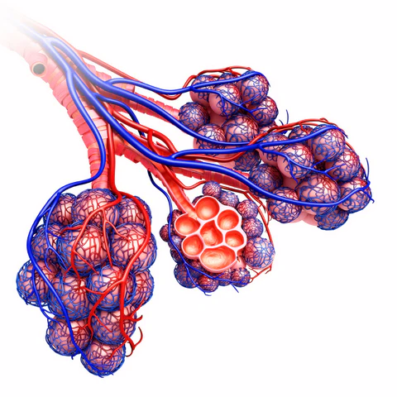
Alveolar blood supply
Deoxygenated blood comes to the lungs via the pulmonary artery, which divides into pulmonary arterioles and then capillaries.
Oxygenated blood in capillaries forms pulmonary venules and then pulmonary veins before returning to the heart for circulation throughout the body.

Slide 12
Questions
Explain why there needs to be a constant flow of blood through the alveolar capillaries.
Explain the role of pleural fluid.
Explain the difference between external respiration, internal respiration and alveolar respiration.
Explain how the concentration gradient is maintained between the alveolus and the blood in the capillaries.
Why is large surface area important for alveolar gas exchange.

Slide 13
Success Criteria
Draw the microscopic structure of alveoli and their capillaries
Describe (name) the blood supplies involved in gas exchange in the lungs
Relate structure to function for gas exchange in the alveoli and capillaries
List and explain the three factors which assist alveolar gas exchange.

